Slide 1
Management & Organisational Behaviour 4
Module Code: ENGE08016

Slide 2
Strategy, Organizational Design and Effectiveness

Slide 3
Learning Objective
Describe the role of strategy when designing an organization.
Describe the key similarities and differences between Porter’s strategy model and Miles and Snow’s strategy typology.
Identify key distinctions among the goal, resource, internal process, and strategic constituents approaches to measuring effectiveness.
Explain the competing values model and how it relates to effectiveness.

Slide 4
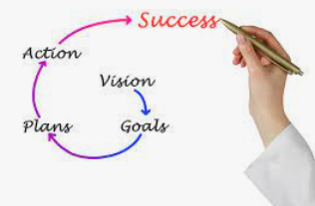
Strategy
Strategy is a plan of action designed to achieve a long-term or overall aim
Image Source: Opstart

Slide 5
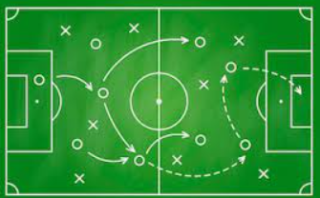
Strategy
Imagine an organization as a soccer team preparing for a match. The organizational strategy is like the game plan the team creates to win the match.
Goal and Objective: The primary goal of the soccer team is to win the game. Similarly, an organization's strategy is centred around achieving its objectives, whether it's gaining market share, increasing revenue, or expanding into new markets.
Formation and Positioning: The soccer team decides on a formation and positions for each player based on their skills and the opponent's strengths and weaknesses. Similarly, an organization strategically positions its departments and resources based on their strengths and the competitive landscape.
Tactics and Plays: The team develops specific tactics and plays to outmanoeuvre the opposition and score goals. Likewise, an organization creates tactical plans to gain a competitive advantage, whether through innovation, cost leadership, or differentiation strategies.
Image Source: Freepik

Slide 6
Strategy
Player Roles and Responsibilities: Each player in the soccer team has a specific role and responsibility to contribute to the team's overall success. Similarly, employees within an organization have defined roles and responsibilities to achieve the organizational goals.
Adaptability and Adjustments: During the match, the team may need to adjust its tactics based on how the game unfolds or the opponent's strategy. Similarly, organizations need to remain adaptable, adjusting their strategies based on market dynamics, customer feedback, or changes in the industry.
Communication and Coordination: Effective communication and coordination among soccer team members are vital to execute the game plan seamlessly. Likewise, in an organization, clear communication and collaboration among teams and departments are crucial to implementing the organizational strategy successfully.
Feedback and Improvement: After the match, the soccer team reviews the game, analyzes what worked and what didn't, and learns from the experience to improve their performance for the next match. Similarly, organizations evaluate the outcomes of their strategies, gather feedback, and use that information to refine and improve their future strategies.
Image Source: Freepik

Slide 7

The Role of Strategic Direction in Organization Design
Organizational goal: A desired state of affairs that an organization attempts to reach
Primary responsibility of top management is to determine an organization’s goals, strategy, and design so that the organization adapts to a changing environment
SWOT analysis: An assessment of the strengths, weaknesses, opportunities, and threats that affect organizational performance
Scenario planning: Involves looking at the current trends and discontinuities and visualizing future possibilities
Image Source: Keynotive

Slide 8
The Role of Strategic Direction in Organization Design
Organizational goals are the desired outcomes or achievements that an organization aims to reach within a specific timeframe. These goals are critical for providing direction, focus, and a sense of purpose to all members of the organization. Establishing clear organizational goals is a fundamental step in the strategic planning process, helping guide decision-making, allocate resources, and assess performance.
Key aspects of organizational goals:
Clarity and Specificity: Goals should be clear, specific, and unambiguous. Ambiguous goals can lead to confusion and lack of direction. Clear goals help everyone in the organization understand what is expected and what they are working towards.
Alignment with Vision and Mission: Organizational goals should align with the broader vision and mission of the organization. The vision outlines the desired future state, while the mission defines the organization's purpose and reason for existence. Goals should be in harmony with these overarching principles.
Relevance and Realism: Goals must be relevant to the organization's current situation and industry. Additionally, they should be realistic and attainable within the resources and time frame available. Unrealistic goals can demotivate employees and undermine credibility.

Slide 9
The Role of Strategic Direction in Organization Design
Key aspects of organizational goals:
Time-Bound: Goals should have a specific time frame for achievement. This time-bound aspect creates a sense of urgency and helps in monitoring progress. Common time frames include short-term (less than a year), medium-term (1-3 years), and long-term (3+ years) goals.
Measurable Metrics: Goals should be quantifiable, allowing for clear measurement of progress and success. Metrics enable the organization to track performance, make adjustments if needed, and celebrate achievements when goals are met.
Hierarchy of Goals: Organizational goals typically follow a hierarchical structure. At the top, you have long-term strategic goals that align with the organization's vision. These are broken down into medium-term and short-term goals that cascade throughout the organization to various departments and teams.
Image Source: Keynotive

Slide 10
The Role of Strategic Direction in Organization Design
Key aspects of organizational goals:
Stakeholder Involvement and Buy-In: It's essential to involve key stakeholders, including employees, in the goal-setting process. When individuals have a say in shaping the goals, they are more likely to buy into the objectives and work diligently to achieve them.
Communication and Transparency: Clear communication of organizational goals to all members is crucial. Transparency regarding the rationale behind the goals, their importance, and how they tie into the organization's overall strategy helps in garnering support and commitment.
Adaptability: Organizational goals should not be set in stone. They should allow for adjustments and modifications based on changing internal and external factors, such as market conditions, emerging opportunities, or unforeseen challenges.
Image Source: Keynotive

Slide 11

The Role of Strategic Direction in Organization Design
The primary responsibility of top management within an organization is to set the overarching direction and framework for the entire organization. This involves determining the organization's goals, devising effective strategies, and designing an adaptable structure that enables the organization to thrive in a constantly changing environment.
Setting Organizational Goals: Top management is responsible for establishing the long-term vision and specific goals of the organization. These goals need to align with the organization's mission and reflect its desired future state. Goals provide a sense of direction, purpose, and focus for all employees within the organization.
Crafting Effective Strategies: Based on the established goals and an assessment of the organization's internal and external environment, top management formulates strategies to achieve these goals. Strategies involve determining the best course of action, allocating resources, identifying competitive advantages, and outlining plans to maximize the organization's success.
Image Source: LinkedIn

Slide 12
The Role of Strategic Direction in Organization Design
Adaptability and Flexibility: In today's rapidly evolving business landscape, being able to adapt to change is crucial. Top management must design strategies and structures that are flexible and can evolve in response to shifts in the market, technology, regulations, consumer behaviour, and other factors. This adaptability allows the organization to stay relevant and competitive over time.
Creating an Agile Organizational Structure: Top management is tasked with designing an organizational structure that supports the chosen strategies and facilitates efficient and effective operations. This includes establishing roles, responsibilities, reporting relationships, and decision-making processes. The structure should promote collaboration, innovation, and rapid response to change.
Resource Allocation and Optimization: Top management oversees the allocation of resources, including finances, human capital, technology, and other assets, to support the execution of the chosen strategies. They ensure that resources are utilized optimally and aligned with the organization's goals and overall strategy.

Slide 13

The Role of Strategic Direction in Organization Design
Risk Management and Mitigation: Identifying and managing risks is a critical aspect of top management's responsibilities. They need to assess potential risks that could affect the organization's ability to achieve its goals and put in place strategies to mitigate these risks effectively.
Communication and Alignment: Top management is responsible for effectively communicating the organization's goals, strategies, and expectations to all levels of the organization. This ensures that every employee understands their role in achieving the organizational goals and can align their efforts accordingly.
Monitoring and Evaluation: Continuously monitoring progress towards achieving the organizational goals and evaluating the effectiveness of strategies is another crucial aspect. Top management needs to collect data, assess performance, and make necessary adjustments to strategies or structures to ensure the organization remains on track.
Image Source: toladata.com

Slide 14
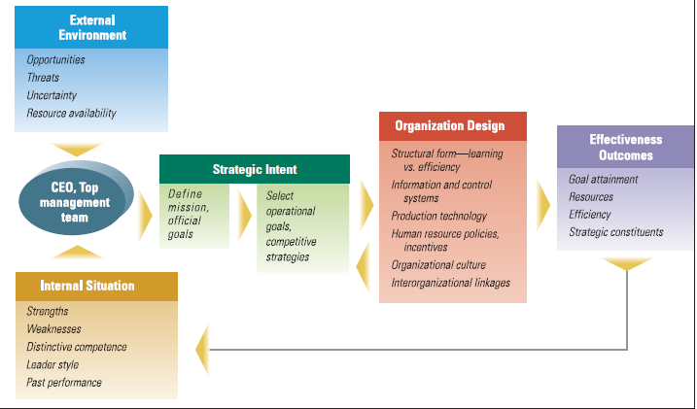
The Role of Strategic Direction in Organization Design
Top Management Role in Organization Direction, Design, and Effectiveness
Image Source: Cengage Learning

Slide 15
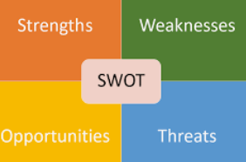
The Role of Strategic Direction in Organization Design
SWOT analysis: An assessment of the strengths, weaknesses, opportunities, and threats that affect organizational performance
SWOT Analysis is a strategic planning tool used to evaluate an organization's internal strengths and weaknesses, as well as its external opportunities and threats. The acronym SWOT stands for Strengths, Weaknesses, Opportunities, and Threats, representing the key components of this analytical framework. This analysis helps organizations identify critical factors that can influence their strategic direction and decision-making.
Image Source: Tallyfy

Slide 16
The Role of Strategic Direction in Organization Design
Strengths (S):
Strengths are the internal attributes and resources that give an organization a competitive advantage and contribute to its success. These can include skilled workforce, advanced technology, strong brand reputation, efficient processes, financial stability, or proprietary intellectual property. Identifying strengths helps organizations leverage their advantages in the market.
Weaknesses (W):
Weaknesses are internal factors that hinder an organization's performance and competitiveness. These could be deficiencies in resources, inadequate skills, outdated technology, poor management, high operational costs, or ineffective marketing strategies. Recognizing weaknesses is crucial to develop strategies for improvement and mitigate potential risks.
Opportunities (O):
Opportunities refer to external factors or situations that an organization can capitalize on to enhance its performance and achieve its goals. These might include emerging markets, technological advancements, changes in consumer behaviour, partnerships, market trends, or regulatory changes. Identifying opportunities helps organizations tailor their strategies to exploit favourable conditions.
Threats (T):
Threats are external factors or challenges that could potentially hinder an organization's growth, profitability, or competitive position. These could include intense competition, economic downturns, technological disruptions, changing consumer preferences, regulatory constraints, or supplier issues. Understanding threats allows organizations to develop contingency plans and risk mitigation strategies.

Slide 17

The Role of Strategic Direction in Organization Design
Scenario planning: Involves looking at the current trends and discontinuities and visualizing future possibilities
Scenario planning, also known as scenario analysis or scenario thinking, is a strategic management tool used by organizations to anticipate and prepare for potential future developments and uncertainties. It involves creating multiple plausible future scenarios and assessing how the organization could respond to each of them. This process helps organizations make more informed and flexible strategic decisions that consider a range of possible outcomes.
Scenario planning is particularly beneficial in uncertain and rapidly changing industries where predicting the future is challenging. It enhances an organization's ability to think critically about potential futures and positions it to make informed, proactive, and agile decisions to navigate a dynamic business landscape effectively.
Image Source: Monday.com

Slide 18
The Role of Strategic Direction in Organization Design
Here's a detailed explanation of scenario planning in an organizational context:
Understanding the Methodology: Scenario planning begins by comprehending the methodology. It's a structured process involving identifying critical uncertainties, constructing scenarios based on these uncertainties, and assessing strategic implications for the organization.
Identifying Key Uncertainties: Organizations identify critical uncertainties that could significantly impact their future. These could encompass changes in technology, market dynamics, regulatory environment, societal attitudes, economic conditions, geopolitical events, or other factors specific to the industry.
Constructing Scenarios: Based on the identified uncertainties, a set of diverse yet plausible scenarios is developed. These scenarios represent different potential futures for the organization. They are usually built by combining different outcomes of the identified uncertainties to create a range of possible situations.
Detailed Scenario Descriptions: Each scenario is given a detailed narrative describing the future environment, including economic conditions, technological advancements, social trends, and more. These narratives help in understanding the context and implications of each scenario.

Slide 19
The Role of Strategic Direction in Organization Design
Impact Assessment and Strategy Formulation: The organization assesses the potential impact of each scenario on its operations, stakeholders, market position, financials, and other relevant areas. Strategies and action plans are then formulated for each scenario to ensure the organization is prepared to respond effectively.
Risk Mitigation and Contingency Planning: Scenario planning helps in identifying risks associated with each scenario. It enables the organization to develop risk mitigation strategies and contingency plans to address challenges that may arise in different potential future situations.
Building Resilience and Flexibility: By exploring multiple scenarios and preparing for various possible futures, the organization builds resilience and flexibility into its strategic approach. This equips the organization to pivot and adapt its strategies swiftly in response to changing circumstances.
Regular Review and Update: Scenarios are not static; they need to be reviewed periodically and updated based on changes in the external environment. As new information and events unfold, the scenarios may evolve, and the organization must adjust its strategies accordingly.

Slide 20

Organizational Purpose
Strategic intent: All the organization’s energies and resources are directed toward a focused, unifying, and compelling goal
Strategic intent refers to a high-level statement or vision that articulates an organization's ambitious and aspirational goals for the future. It goes beyond traditional goal-setting by outlining a long-term direction that challenges the organization to achieve significant accomplishments, often positioning itself as an industry leader or a disruptor in its domain.
Three aspects of strategic intent:
Mission
Competitive advantage
Core competence
Image Source: QS Study

Slide 21
Organizational Purpose: Strategic Intent
Mission
The mission of an organization is a fundamental statement that defines its purpose, reason for existence, and the value it intends to create for its stakeholders. It answers the question: "What does the organization aim to achieve?" The mission is typically enduring and encompasses the organization's contributions to society, its target audience, and the scope of its activities.
Competitive advantage
Competitive advantage refers to the unique attributes, capabilities, or advantages that enable an organization to outperform its competitors in the marketplace. It is what sets the organization apart and positions it favourably against rivals. This advantage can be in the form of cost leadership, differentiation, focus, innovation, or a combination of these. Competitive advantage directly aligns with the organization's mission and strategic intent, helping it achieve its goals more effectively than its competitors.
Core competence
Core competence represents the collective strengths, capabilities, and specialized knowledge that an organization possesses, forming the basis for its competitive advantage. These are unique skills and resources that are difficult for competitors to replicate and provide a distinct advantage in the market. Core competencies align with the organization's mission and strategic intent, serving as the foundation for achieving the envisioned future.

Slide 22
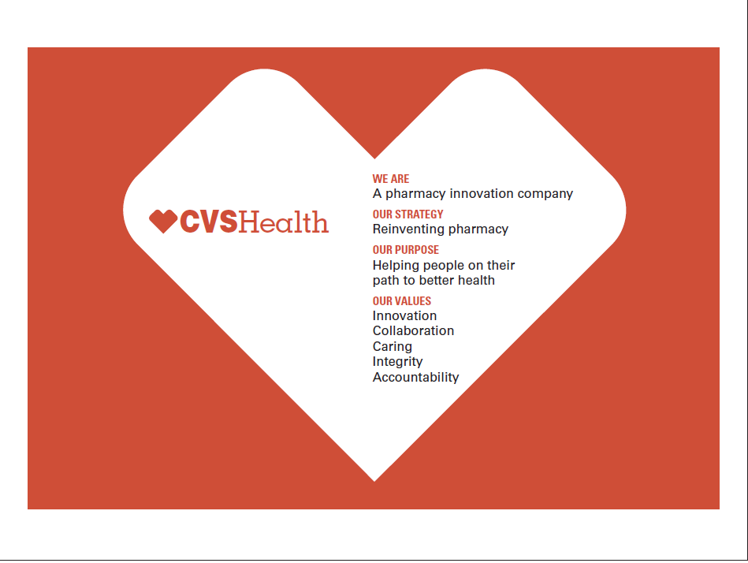
Organizational Purpose: Strategic Intent
Image Source: Cengage Learning

Slide 23
Organizational Purpose: Strategic Intent
Strategic Intent: CVS Health's strategic intent aligns with their mission and has historically aimed to evolve beyond a traditional pharmacy and retail company. They aspire to transform the healthcare experience for individuals and communities by integrating a comprehensive range of health services, innovative technologies, and data analytics to make healthcare more accessible, affordable, and effective.
Mission: CVS Health's mission has been centred around helping people on their path to better health. The mission underscores their commitment to providing high-quality healthcare services, medications, and wellness products to improve the health and well-being of their customers and communities.
Competitive Advantage: CVS Health has sought a competitive advantage through its vertically integrated business model, combining retail pharmacy, health insurance (through Aetna, which they acquired), pharmacy benefit management, and healthcare clinics (MinuteClinic). This integration aims to offer a seamless and holistic healthcare experience to customers, improving convenience and outcomes while managing costs.
Image Source: Cengage Learning

Slide 24
Organizational Purpose: Strategic Intent
Core Competence: CVS Health's core competencies include extensive retail and pharmacy networks, expertise in pharmacy benefit management (PBM), health insurance capabilities (Aetna), digital health technologies, data analytics, and a focus on community health. Leveraging these competencies, CVS Health aims to address healthcare gaps, drive innovation, and deliver personalized solutions for better health outcomes.
Image Source: Cengage Learning

Slide 25
Organizational Purpose: Operating Goals
Operating goals:
Designate the ends sought through the actual operating procedures of the organization
Explain what the organization is actually trying to do
Describe specific measurable outcomes
Are often concerned with the short run
Typically pertain to the primary tasks an organization must perform
Examples of operating goals:
Overall performance, resource, market, employee development, innovation and change, productivity
Improving customer service response times, reducing production costs by a certain percentage, increasing sales in a specific product line, enhancing employee training and development, or optimizing supply chain processes.
Goal conflict:
Pursuing some goals means that others have to be delayed or set aside

Slide 26
Organizational Purpose: Operating Goals
Operating goals, are specific, tangible, and achievable objectives that guide the day-to-day activities and functions within an organization. These goals are directly linked to the organization's overall strategic objectives and are designed to support the fulfilment of the broader mission and vision. Operating goals are typically set for the short to medium term and are critical for executing the organization's strategy effectively and efficiently.
Key aspects of operating goals:
Alignment with Strategy: Operating goals are aligned with the organization's strategic objectives. They are derived from the broader strategic plan and help break down high-level strategies into actionable and measurable steps that can be implemented at the operational level.
Specific and Measurable: Each operating goal should be specific and quantifiable, enabling clear measurement of progress and success. This ensures that progress can be tracked and evaluated against predetermined metrics and targets.
Realistic and Achievable: Operating goals must be realistic and achievable within the given timeframe and available resources. Setting unattainable goals can demotivate employees and hinder progress, while achievable goals inspire confidence and productivity.
Time-Bound: Operating goals are set with a specific timeframe or deadline for completion. This time-bound nature adds a sense of urgency and helps in prioritizing actions and allocating resources accordingly.

Slide 27
Organizational Purpose: Operating Goals
Key aspects of operating goals:
Relevance to Operations: Operating goals are directly related to the day-to-day operations of the organization. They focus on improving processes, enhancing productivity, optimizing resource utilization, and achieving other operational efficiencies.
Responsibility and Accountability: Each operating goal should have a designated individual or team responsible for its achievement. Clear accountability ensures that progress is monitored, and corrective actions can be taken if necessary.
Integration and Interconnectedness: Operating goals should be interconnected and contribute to the overall organizational success. They need to integrate with each other to ensure alignment and synergy across different operational areas.
Regular Review and Feedback: Operating goals should be reviewed periodically to assess progress, identify any deviations, and make necessary adjustments. Regular feedback and performance evaluations are crucial for ensuring that the goals remain relevant and achievable.

Slide 28
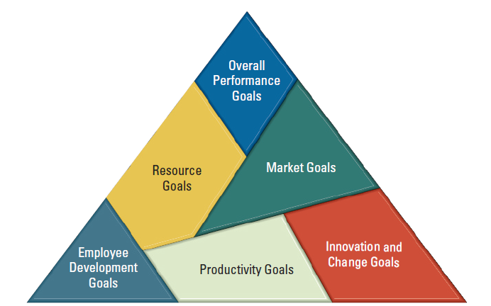
Organizational Purpose: Operating Goals
Typical Operating Goals for an Organization
Image Source: Cengage Learning

Slide 29
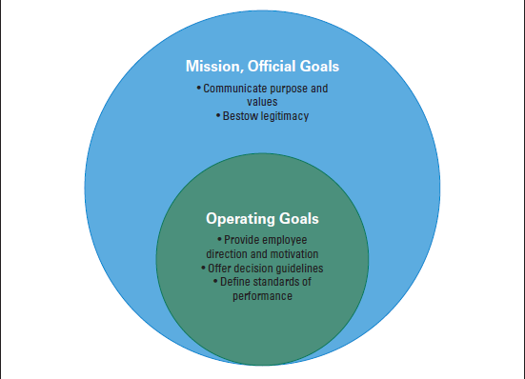
Organizational Purpose: Operating Goals
Goal Types and Purposes
Image Source: Cengage Learning

Slide 30
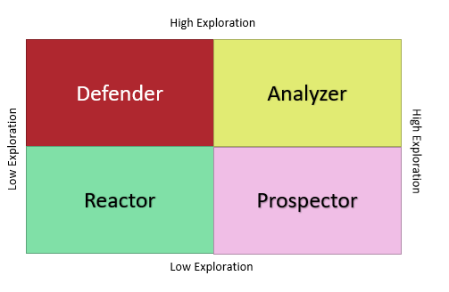
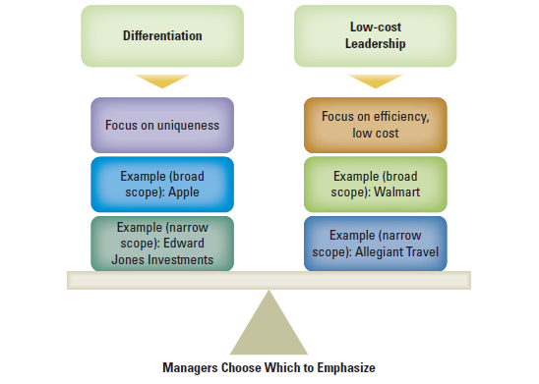
Two Frameworks for Selecting Strategy and Design
A strategy is a plan for interacting with the competitive environment
Strategies can include any number of techniques to achieve the goal
Models exist to aid in formulating strategy:
Porter Model of Competitive Strategies
Miles and Snow Strategy Typology
Image Source: Cengage Learning
Image Source: Drawn in Visio

Slide 31
Two Frameworks for Selecting Strategy and Design
Porter Model of Competitive Strategies
Michael Porter studied a number of business organizations and proposed that managers can make the organization more profitable and less vulnerable by adopting either a differentiation strategy or low-cost leadership strategy.
Using a low-cost leadership strategy means that managers choose to compete through lowering costs.
The cost leadership strategy involves becoming the lowest-cost producer or provider of a product or service in the industry.
Companies following this strategy aim to achieve economies of scale, efficient operations, cost-efficient supply chains, and cost minimization at every stage of production and distribution.
The goal is to offer products or services at lower prices than competitors while maintaining acceptable levels of quality.
Image Source: Cengage Learning

Slide 32
Two Frameworks for Selecting Strategy and Design
Using a differentiation strategy means that the organization competes through the ability to offer unique or distinctive products and services that can command a premium price.
The differentiation strategy focuses on offering unique or distinct products or services that are valued by customers.
Companies employing this strategy invest in research, design, branding, marketing, and quality to create a product or service that stands out in the market.
The aim is to command a premium price for the distinctive features, quality, or brand image of the product or service.
Image Source: Cengage Learning

Slide 33
Two Frameworks for Selecting Strategy and Design
Porter's model emphasizes that businesses should choose and focus on one of these strategies rather than attempting to pursue both cost leadership and differentiation simultaneously, as this can result in a "stuck in the middle" scenario with higher costs and no distinct market advantage.
It's important to note that the competitive environment is dynamic, and companies may need to adjust their strategies over time based on changes in market conditions, technology, consumer preferences, and competitive pressures.
Additionally, a combination of these strategies or hybrid strategies may be used to suit the specific circumstances of a company and its industry.
Image Source: Cengage Learning

Slide 34
Two Frameworks for Selecting Strategy and Design
Miles and Snow Strategy Typology
The Miles and Snow Strategy Typology is a strategic management framework developed by Raymond E. Miles and Charles C. Snow in the 1970s.
It classifies organizations into four strategic types based on their approach to dealing with and adapting to the external business environment.
In the context of the Miles and Snow Strategy Typology, "exploration" refers to an organization's willingness and ability to actively search for new opportunities, markets, technologies, and innovative strategies to gain a competitive advantage. It involves being proactive, innovative, and open to changes and new ventures
This typology helps businesses understand their strategic orientation and responses to market dynamics.
The four strategic types are:
Defender
Analyzer
Reactor
Prospector

Slide 35
Two Frameworks for Selecting Strategy and Design
Miles and Snow Strategy Typology: Defender
Characteristics:
Maintains a stable and secure market position.
Focuses on efficiency, cost control, and operational excellence.
Defends its existing market share against competitors.
Strategic Approach:
Concentrates on a narrow market segment or product line.
Efficiently produces and delivers existing products or services.
Protects its market position through brand loyalty, cost leadership, and quality.
Example:
Utility companies often adopt a defender strategy, maintaining a stable market presence and focusing on operational efficiency.
Image Source: Drawn in Visio

Slide 36
Two Frameworks for Selecting Strategy and Design
Miles and Snow Strategy Typology: Analyzer
Characteristics:
Balances elements of both prospectors and defenders.
Adopts a moderate level of risk-taking and innovation while also maintaining stability in the existing market.
Watches and imitates successful innovations from prospectors.
Strategic Approach:
Focuses on improving and expanding existing products or services.
Maintains a presence in established markets while exploring new opportunities cautiously.
Watches and adopts successful strategies of prospectors to stay competitive.
Example:
Large retail chains that maintain a stronghold in their core markets while cautiously expanding into emerging markets and e-commerce
Image Source: Drawn in Visio

Slide 37
Two Frameworks for Selecting Strategy and Design
Miles and Snow Strategy Typology: Reactor
Characteristics:
Lacks a consistent and coherent strategic approach.
Reacts to environmental changes rather than proactively shaping its strategy.
Often changes strategies abruptly in response to crises or competitive pressures.
Strategic Approach:
Lacks a clear, defined strategy and long-term direction.
Tends to be disorganized and fragmented in its responses to market changes.
Struggles to maintain stability and competitive positioning due to inconsistent reactions.
Example:
Small and struggling businesses that lack a clear strategic direction and frequently change their business approach based on external influences.
Image Source: Drawn in Visio

Slide 38
Two Frameworks for Selecting Strategy and Design
Miles and Snow Strategy Typology: Prospector
Characteristics:
Innovative and risk-taking approach.
Focuses on market opportunities and growth.
Continuously seeks new markets, products, and technologies.
Strategic Approach:
Emphasizes flexibility, adaptability, and innovation.
Proactively explores and exploits new markets and product niches.
Constantly searches for new opportunities to stay ahead of competitors.
Example:
Technology companies frequently fall into this category as they constantly innovate and explore new markets and technologies.
Image Source: Drawn in Visio

Slide 39
Key similarities and differences in Strategies
Porter's Strategy Model and the Miles and Snow's Strategy Typology are both strategic management frameworks that provide insights into how businesses can gain a competitive advantage. While they share the goal of achieving a competitive edge, they have distinct approaches and focus areas.
Similarities:
Competitive Advantage:
Both models are centred around achieving a competitive advantage in the industry.
They emphasize the importance of strategic choices and actions to outperform competitors and succeed in the market.
Strategic Planning:
Both models are frameworks for strategic planning and decision-making within organizations.
They guide companies in understanding their competitive position and making informed choices regarding their strategies.
Adaptation to External Environment:
Both models acknowledge the importance of adapting to the external environment, including market conditions, customer preferences, and competition.
Strategies in both models are designed to align with the opportunities and threats present in the external business environment.

Slide 40
Key similarities and differences in Strategies
Differences:
Focus and Approach:
Porter's Model: Primarily focuses on how a company can gain a competitive advantage through cost leadership, differentiation, or focus. It provides a clear roadmap for choosing one of these generic strategies.
Miles and Snow's Typology: Focuses on the relationship between an organization and its external environment, classifying organizations into four strategic types based on their responses to environmental changes and opportunities.
Generic Strategies vs. Adaptive Strategies:
Porter's Model: Suggests three generic strategies—cost leadership, differentiation, and focus—which are seen as enduring approaches for achieving competitive advantage.
Miles and Snow's Typology: Classifies organizations into four adaptive strategies—Prospector, Defender, Analyzer, and Reactor—based on their responses to environmental changes and their approaches to innovation, risk-taking, and stability.

Slide 41
Key similarities and differences in Strategies
Differences:
Long-Term vs. Adaptive Orientation:
Porter's Model: Focuses on a long-term orientation, aiming for a sustainable competitive advantage through the chosen generic strategy.
Miles and Snow's Typology: Focuses on short to medium-term adaptive strategies based on the organization's approach to environmental changes.
Flexibility vs. Stability:
Porter's Model: Provides a more rigid framework with clear choices of cost leadership, differentiation, or focus, requiring stability and adherence to the chosen strategy.
Miles and Snow's Typology: Acknowledges the need for strategic flexibility and adaptation to changing market conditions, encouraging organizations to adjust their strategies based on the evolving environment.
Both Porter's Strategy Model and Miles and Snow's Strategy Typology aim to guide organizations toward competitive advantage, they differ in their approach, focus, and level of strategic flexibility. Porter's model offers a clear choice among generic strategies, while Miles and Snow's typology emphasizes the importance of adaptive strategies in response to environmental changes.

Slide 42

Measuring Organization Effectiveness
Measuring organizational effectiveness involves assessing the extent to which an organization is achieving its goals, utilizing its resources efficiently, and fulfilling its mission in a manner that aligns with its values and objectives. It's a comprehensive evaluation of the organization's performance and impact, considering both internal processes and external outcomes. The purpose of measuring organizational effectiveness is to understand how well the organization is functioning and identify areas for improvement
Image Source: Business.com

Slide 43
Measuring Organization Effectiveness
Measuring organizational effectiveness is crucial for businesses to assess their performance, make informed decisions, and improve their strategies.
The goal, resource, internal process, and strategic constituents approaches are different methodologies used to measure effectiveness. Overall effectiveness is difficult to measure in organizations because they are large, diverse and fragmented. Organizations perform many activities simultaneously, pursue multiple goals and generate many outcomes. Managers determine what indicators to measure in order to gauge the effectiveness of their organization.
Here are the key distinctions among these approaches:
Goal Approach:
Focus: The goal approach centres on the achievement of predetermined objectives or goals set by the organization.
Measurement Emphasis: Effectiveness is measured by how well the organization attains its defined goals, targets, or outcomes.
Key Metrics: Metrics revolve around goal attainment, such as reaching revenue targets, market share goals, customer satisfaction levels, or specific project milestones.
Criticism: Critics argue that this approach might overlook the means and processes used to achieve the goals, potentially ignoring ethical or long-term sustainability considerations.

Slide 44
Measuring Organization Effectiveness
Resource Approach:
Focus: The resource approach emphasizes the efficient utilization of resources to achieve organizational objectives.
Measurement Emphasis: Effectiveness is measured by evaluating how efficiently and effectively resources (e.g., financial, human, technological) are utilized to achieve goals.
Key Metrics: Metrics include return on investment (ROI), cost-efficiency ratios, resource utilization rates, and productivity indicators.
Criticism: Critics contend that focusing solely on resource efficiency may neglect the actual impact and outcomes of the organization's actions.
Internal Process Approach:
Focus: The internal process approach concentrates on assessing the quality and efficiency of internal processes and operations.
Measurement Emphasis: Effectiveness is measured by evaluating the organization's internal processes, procedures, and workflows to ensure they contribute to achieving organizational goals.
Key Metrics: Metrics involve process efficiency, cycle times, error rates, compliance with standards, and operational effectiveness.
Criticism: Critics argue that this approach may neglect external influences and outcomes, potentially overlooking the actual impact on stakeholders and the market.

Slide 45
Measuring Organization Effectiveness
Strategic Constituents Approach:
Focus: The strategic constituents approach centres on considering various stakeholders' perspectives and their influence on organizational effectiveness.
Measurement Emphasis: Effectiveness is measured by evaluating how well the organization meets the expectations and needs of key stakeholders (e.g., customers, employees, shareholders, communities).
Key Metrics: Metrics include customer satisfaction, employee engagement, stakeholder feedback, reputation indices, and community impact assessments.
Criticism: Critics caution that the challenge lies in determining which stakeholders to prioritize and balancing their often diverse and sometimes conflicting expectations.
These approaches provide different lenses through which organizational effectiveness can be assessed, whether focusing on achieving goals, optimizing resource utilization, improving internal processes, or meeting stakeholder expectations. Organizations often integrate aspects of multiple approaches to gain a comprehensive understanding of their performance and effectiveness.

Slide 46
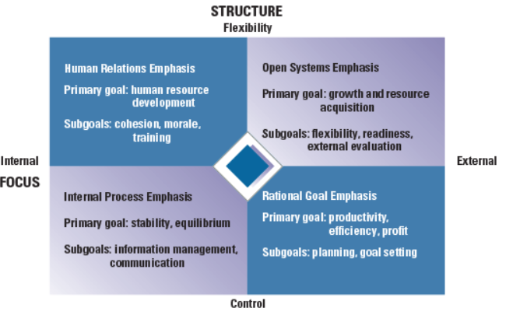
Competing Values Model
Image Source: Cengage Learning

Slide 47
Competing Values Model
The competing values model tries to balance a concern with various parts of the organization rather than focusing on one part.
This approach to effectiveness acknowledges that organizations do many things and have many outcomes. It combines several indicators of effectiveness into a single framework.
This model is based on the assumption that there are disagreements and competing viewpoints what constitutes effectiveness.
Managers sometimes disagree over which are the more important goals to pursue and measure.
Image Source: Cengage Learning

Slide 48

Competing Values Model
Case Study 1: NASA
One tragic example of conflicting viewpoints and competing interests comes from NASA.
After 7 Astronauts died in the explosion of the space shuttle Columbia 2003 and investigative committee found deep organizational flaws at NASA including ineffective mechanisms for incorporating dissenting opinions between scheduling managers and safety managers.
External pressures to launch on time overrode safety concerns with the Columbia launch.
Image Source: NASA

Slide 49

Competing Values Model
Case Study 2: BP
Similar incident congressional investigations of the 2010 Deepwater Horizon oil rig explosion and oil spill in the Gulf of Mexico found that BP engineers and managers made a number of decisions that were counter to the advice of key contractors putting goals of cost control and timelines ahead of concerns over well safety.
BP and NASA represent how complex organizations can be, operating not only with different viewpoints internally but also from contractors, government regulators, congress and the expectations of the American public.
Image Source: BP

Slide 50
Competing Values Model
The competing values model takes into account such complexities outlined in the two case studies in previous slides.
The model was originally developed by Robert Quinn and John Rohrbaugh to combine a the diverse indicators of performance used by managers and researchers.
Using a comprehensive list of performance indicators, a panel of experts in organizational effectiveness rated the indicators for similarity.
Their analysis found underlying dimensions of effectiveness criteria that represented competing management values in organizations.
Image Source: Cengage Learning

Slide 51
Competing Values Model: Indicators
The square matrix chart gives the following effectiveness values:
Organization with flexible structure and internal focus has Human Relations Emphasis.
Primary Goal: Human Resource Development
Sub Goals Cohesion, Morale and Training
Organization with Flexible Structure and External Values has Open System Emphasis
Primary Goal: Growth and Resource Acquisition
Sub Goals: Flexibility, Readiness and External Evaluation
Image Source: Cengage Learning

Slide 52
Competing Values Model: Indicators
The square matrix chart gives the following effectiveness values:
Organization with Controlled Structure and Internal Focus has Internal Process Emphasis.
Primary Goal: Stability and Equilibrium
Sub Goals: Information Management and Communication
Organization with Controlled Structure and External Focus has Rational Goal Emphasis
Primary Goal: Productivity, Efficiency and Profit
Sub Goals: Planning and Goal Setting
Image Source: Cengage Learning

Slide 53

Competing Values Model: Indicators
Managers decide which values in this matrix will take priority within the organization.
Example:
Managers at Stryker Corporation which make surgical equipment and implants used for joint replacements amongst other medical devices, emphasize the values of openness and flexibility to keep people throughout the company innovating on a day to day basis. Yet the company also has values of control and efficiency.
Image Source: Cengage Learning
Image Source: Stryker

Slide 54
Organizational Design Essentials
Leaders’ choices of mission and purpose influence how the organization should be designed and have a tremendous impact on organizational effectiveness.
Setting a direction for the organization begins with top leaders looking at both the external environment and the organization’s internal situation.
Operating goals designate specific ends sought through the actual operating procedures of the organization.
Official and operating goals are a key element in organizations because they meet certain needs, such as providing employees with a sense of direction and motivation.
Strategies may include any number of techniques to achieve the stated goals.
Organization design should fit the firm’s competitive approach and the various contingency factors to contribute to organizational effectiveness.

Slide 55
Organizational Design Essentials
No easy, simple, guaranteed measure will provide an unequivocal assessment of effectiveness.
To be successful, organizations must perform diverse activities well.The competing values model acknowledges different areas of focus (internal, external) and structure (flexibility, stability) and allows managers to choose the values to emphasize in their organization

Slide 56
Learning Objectives Completed
Describe the role of strategy when designing an organization.
Describe the key similarities and differences between Porter’s strategy model and Miles and Snow’s strategy typology.
Identify key distinctions among the goal, resource, internal process, and strategic constituents approaches to measuring effectiveness.
Explain the competing values model and how it relates to effectiveness.

